Slide 1
Off Premise Catering
Chapter 14 – Budgeting, Accounting and Financial Management

Slide 2
Preparing A Budget
Always have a plan – (Budget)
Your budget is your plan for operating a business expressed as a financial plan
Common mistakes are to assume unrealistic revenues and assume large financial obligations

Slide 3
Budget Steps
Based on history
Number of events per year
Average Selling Price of each event
Seasonal Variations
National and Local Economic indicators
Competitive Factors
Industry Trends

Slide 4
Budget by month – not year
Bills must be paid monthly –
Can chart achievement of revenue goals
Lean months and fat months
Watch how holidays fall
Can develop reactions if revenues fall short of goals in a particular month

Slide 5
Expense Categories
Cost of Sales
Food Costs
Payroll and related costs
Labor plus benefits
Direct Operating Costs
Supplies, transportation, utilities, advertising
Administrative and General Costs
Office expenses, Insurance, rent, repairs and maintenance

Slide 6
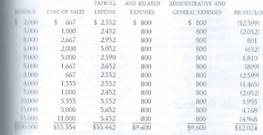
Sample Budget

Slide 7
Start Up Expenses
To be Determined by the –
Type of Operation
Style of Operation
Projected first year sales
Estimated rate of growth
Market
Barriers to entry – (i.e. Permits, etc.)

Slide 8
Cash Budgeting
A Cash Budget accounts for the actual flow of cash through an operation – different from an income and expense budget
Income from a catered event is recorded on the day the event occurs, but the the flow could be different
Expenses – purchases on credit can be paid the following month
Labor expenses typically are paid immediately

Slide 9
Differences -
On an Income and Expense budget-
An annual insurance policy, while paid in one or more payments, is spread over 12 months
A Cash Budget –
The annual insurance payment is recorded by the actual way it is done – (quarterly for example)

Slide 10
Cash Flow Statement
Assumptions –
A. All clients are paying a 50% deposit due 30 days prior to the event
B. Cost of sales is paid the month following the event
C. Administrative and General expenses are paid in the month
D. The caterer has a $3,000 Insurance premium, $1,000 paid in January – the rest over 10 months ($200)

Slide 11
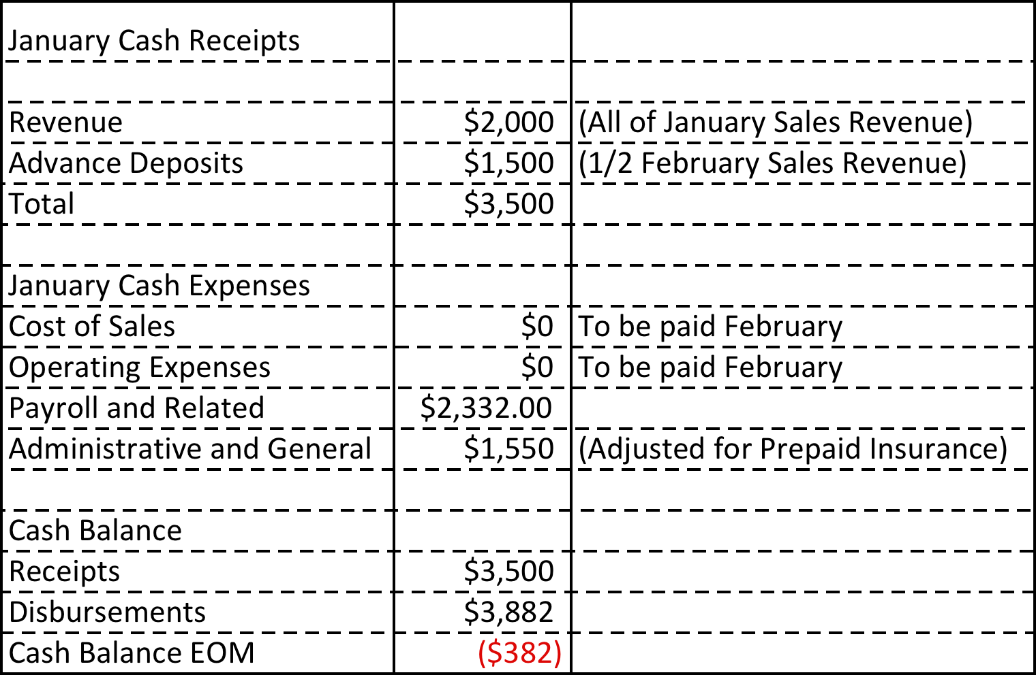
Example
January Cash Flow

Slide 12
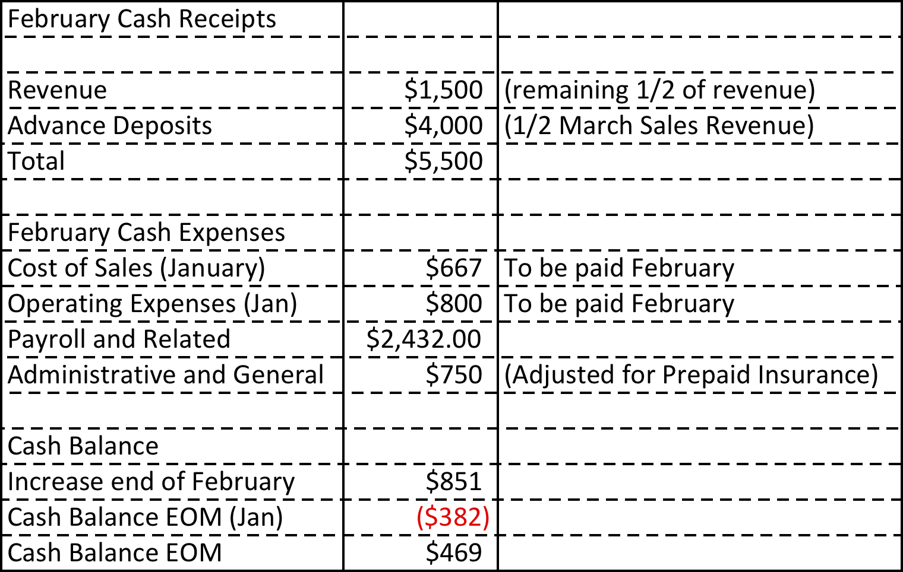
February Cash Flow

Slide 13
Break Even Points
You Must know the break even point
Variable
Costs of goods sold (33 1/3 % of revenues)
Payroll and related (part timers) (10% of revenues)
43 1/3 % of revenues total
Fixed
Fixed Monthly Payroll
Administrative & General

Slide 14
Calculating Break Even
Many ways to calculate -
Fixed Costs / Contribution Margin = Break Even
$3,732 / .5667 (contribution margin) = $6,585
Break even point on any given month is $6,585.

Slide 15
Revenues and Expenses
Basic Accounting –
Simple – but does not replace a CPA, especially for tax purposes
Records need to be kept on a daily basis
Accounting software – QuickBooks, etc.
Basic records are Income Statement and Balance Sheet

Slide 16
Journals
The basic component of accounting is the journal
The “name” typically describes the type of information recorded
Example:
Sales and Cash Receipts journal
Advance deposits
Food Sales
Labor charges
Corkage and other beverage fees
Rentals and equipment
Accessory Services
Service charges
Sales taxes
Totals

Slide 17
When a figure is entered into the journal it is called “posting” an entry
The figure is called a “journal entry”

Slide 18
Types of Journals
Petty Cash Journal
Advance Deposit Journal
Until the event is concluded this is a “liability”
Forfeited deposits are considered “other income”
Cash Disbursements Journal
Payroll Journal
All journals feed to the main statements

Slide 19
Chart of Accounts
UCA – Uniform Chart of Accounts – Accounting standard
Revenue Accounts –
Food Revenues
Beverage Revenues
Equipment Revenues
Floral and Décor Revenues
Music and Entertainment Revenues
Other Services revenues
Sales taxes collected

Slide 20
Expense Accounts
Cost of Sales Accounts
Cost of Food
Cost of Beverage
Cost of Equipment
Cost of Floral and Décor
Cost of Music and Entertainment
Cost of Other Services
Payroll and Related Costs

Slide 21
Expense Accounts
Direct Operating Costs
Uniforms
Laundry
Replacement costs
Supplies
Transportation
Licenses and Permits
Advertising and Promotion
Utilities
Sales Taxes payment to State
Misc.

Slide 22
Expense Accounts
Administrative and General
Office Supplies, Printing, Postage
Telephone
Data Processing Costs
Dues and Subscriptions
Insurance
Fees to Credit Organizations
Professional Fees
Miscellaneous
Repairs and maintenance
Rent and Lease Expense

Slide 23
Income Statement Summary
Cost of Sales Calculation -
Basic formula is –
Value of beginning inventory
Plus (+) purchases
Less (-) value of ending inventory
Less (-) employee meals and other credits
Equals – Total cost of sales
Accurate inventory accounting is critical

Slide 24
Payroll Calculation
Gross Wages
Plus (+) employers share of FICA
Plus (+) federal and state unemployment
Plus (+) cost of employee meals
Plus (+) cost of workers compensation insurance
Equals (=) total payroll and related
Other employee benefits (insurance, etc.) are included in this category

Slide 25
Prepaid
Pre Paid expenses can be spread through the year or taken as a lump sum
Spreading the expenses through the year avoids huge “losses” in particular months.

Slide 26
Income Statement
Food Revenues – Includes food sales and labor charges, service charges and sales taxes
Beverage Sales – Includes beverage sales, and sales of related items. Also, Beverage specific labor charges, alcohol taxes and other beverage taxes
Accessory Services Revenue
Equals (=) Total Revenue

Slide 27
Expense Side
Beverage Cost of sales
Food Cost of sales
Equipment Cost of Sales
Accessory Services Cost of Sales
Equals (=) Total Cost of Sales

Slide 28
Payroll and Related
Direct Activity Profit – The amount remaining after deducting payroll and remaining from the gross margin
Operating Expenses and Administrative and General Expenses are last

Slide 29
The Balance Sheet
Shows Assets, Liabilities and net worth
Assets include
Cash on hand
Accounts receivable
Food and other inventory
Prepaid expenses
Fixed Assets (depreciation )

Slide 30
Liabilities
Outstanding Loans
Advance Deposits for future events
Accounts payable
Accrued Payroll

Slide 31
Understanding Financial Statements
Month to month and year to year are best comparisons
Watch Percentages for revenues and expenses, as well as payroll
Calculate “Average Check” – revenue per guest
Don’t neglect fixed and other operating costs.

Slide 32
Balance Sheets
Accounts Receivable
Too High?
Seasonal fluctuations
Aging by
Current
Over 30
Over 60
Over 120 -

Slide 33
Controlling Costs
Daily Function
Checking Trash
Counting rental equipment
Schedule intelligently
Monitor Utility costs
Labor saving devices
Safety hazards
Watch the percentages
Break down costs by sales (chicken vs. beef)

Slide 34
Next Week
Final Quiz
Review for Final Exam

